Slide 1
Summary for CPW
Zhuo Shen

Slide 2


Basic properties
Resonance frequency: effective dielectric constant is roughly For silicon wafer, 𝟄_sub is about 11.9
Qext is controlled by the coupling capacitance: the higher the capacitance the lower the Qext. We want to design for overcoupled, which is Qext << Qint. Qint is usually about 10^5, which is related to the conductor attenuation constant, and cannot be adjusted easily.
Fitting S21 measurement with the ABCD matrix can find various parameters about the CPW, such as the coupling capacitance and attenuation constant.
Detailed calculations refer Goppl’s paper: https://doi.org/10.1063/1.3010859
My reproduction and calculation can be found in section 1 in my Python code in the repository.
Software TX-Line can calculate the frequency and characteristic impedance of given geometry of CPW and more.

Slide 3
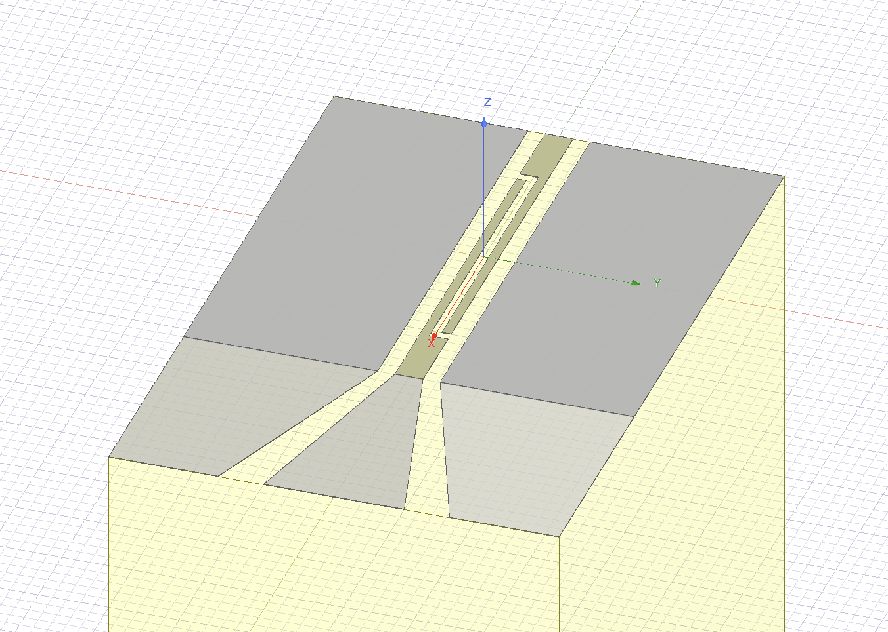
Design the coupling capacitance
Use Ansys Maxwell(in Tobias Frey thesis): Finite Element Analysis for statistical solution: Design a small part for the coupling capacitor and find capacitance across interested section.
I included various Maxwell capacitor models in my repository.
Use Ansys HFSS(in Healey thesis): FEA for dynamical solution, will require more calculations. Refer to Sec 9.
Maxwell model for capacitor

Slide 4
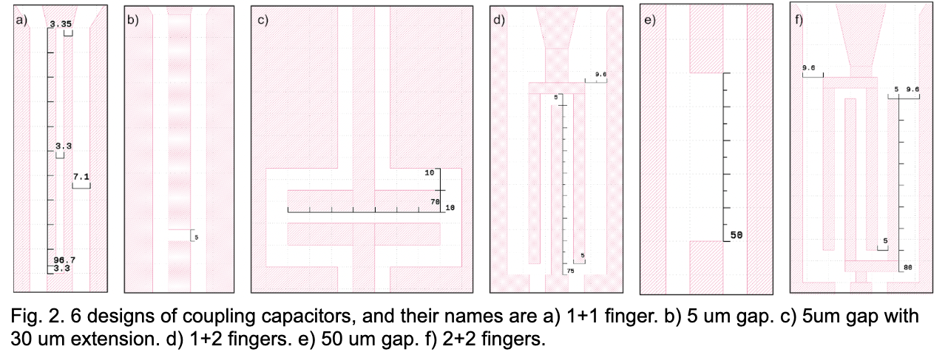
Mask design
I created a set of different coupling capacitors in KLayout. Their geometries, names, and corresponding simulated capacitance values are below (ETH is a 1+1 finger design).
The mask has two portions. The upper half is to be used with positive photolithography, while the lower half is for negative.
The mask file can also be found in my repository.

Slide 5
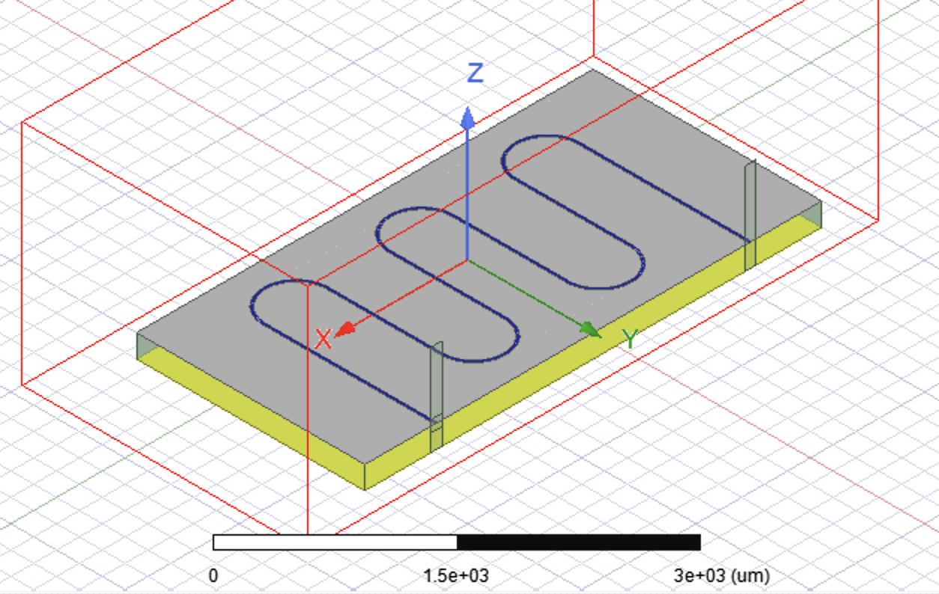
HFSS simulation
In KLayout, we can export the resonator design as DXF file, which can be imported to HFSS directly. There might be dimension and unit differences need to fix in HFSS.
Simulate CPW metal part as 2D perfect E sheet is good enough. The simulation results in difference between 2D sheet and 3D structure with thickness is small. Detailed justification and model can be found in Appx. A in Healey thesis.
I modeled a simplified CPW with 2D sheet and 3D 100 nm structure, and the results only differ a little. Also, 3D structure needs more mesh elements.
Need to design wave port excitation with appropriate size and shape, which is very important. It can change the S21 simulation dramatically. More details in the port tutorial.
I extended the center conductor to the edge to touch the wave port directly. It can help define an appropriate port shape.

Slide 6
S21 result
Due to the unknown problems(probably limited number of mesh elements), the ET2 simulation will give different results, sometime even no resonance at all. One way to fix it is to change the thickness of the substrate a little and run the simulation again till see the peak.
I saved one successful S21 result in s2p file. For manipulating s2p files in Python, see scikit-rf.
For simplified straight line CPWs, Q values and f0 are about the same for 2D sheet and 3D 100nm thickness.
For 2D ET2, f0 is about 5.66 GHz, and QL, Qint, Qext are 5057, 14320, 7819 from ABCD fitting. Close to the literature(Tobias Frey thesis), but Qint is larger due to the lower attenuation constant in simulation.

